Slide 1
CODEX Summer '19
© Copyright 2019, California Institute of Technology, All Rights Reserved.
Patrick Kage
This research was carried out by the Jet Propulsion Laboratory, California Institute of Technology, under a contract with the National Aeronautics and Space Administration.

Slide 2
CODEX Overview
Better data insights.

Slide 3
Know
Thy
Data
CODEX
COmplex Data EXplorer
Notes:
Coolest logo

Slide 4
Why CODEX?
Rationale
First pass analytics are hard to do right
Tedious
Disastrous if wrong
Goals of project
Explore time series data
Aim to replace the “collection of scripts” everyone has
Not replacing MATLAB/Python
Fast and interactive
Visual guidance for every action
Build intuition about the data

Slide 5
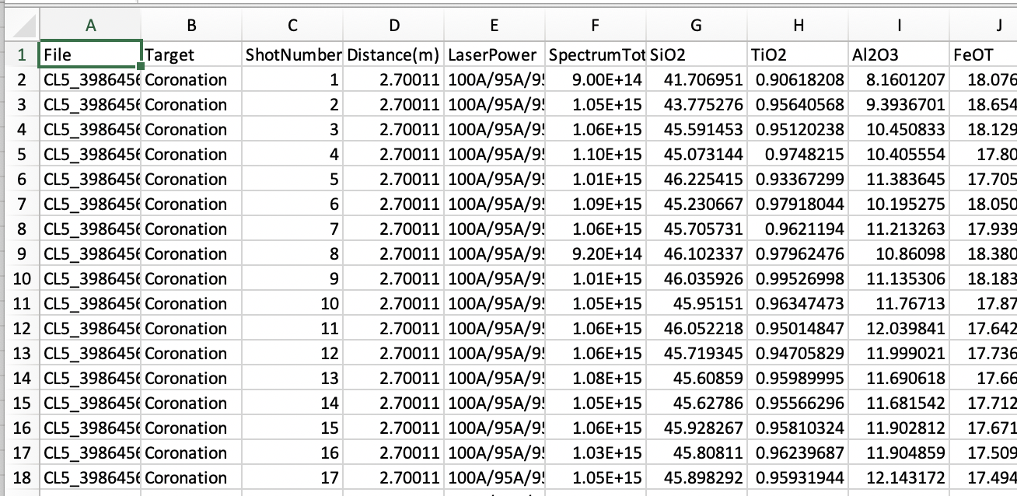
Nomenclature
Time Series
Series of observations from a wide array of sources over time
Not necessarily in temporal order
Features
A column in this dataset referring to a set of observations from one source
Row
A single row in that dataset corresponding to a single point in time

Slide 6
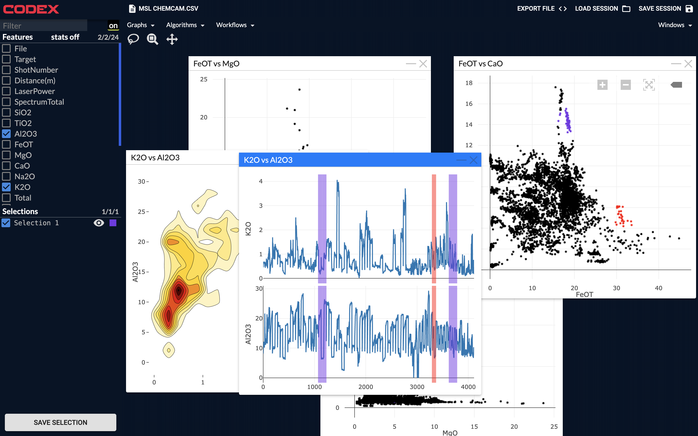

Slide 7
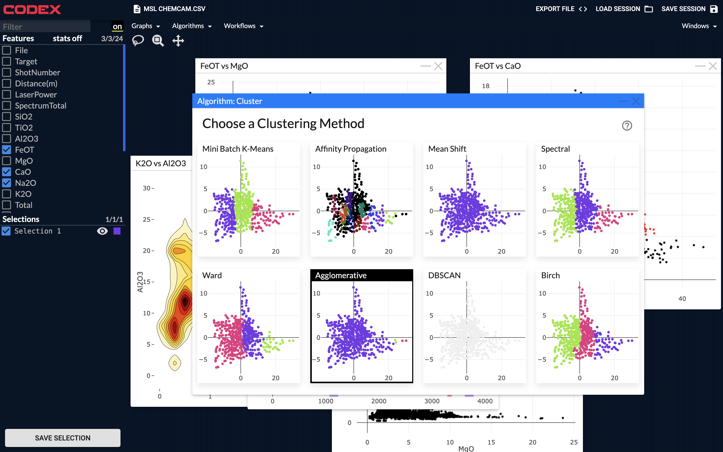

Slide 8
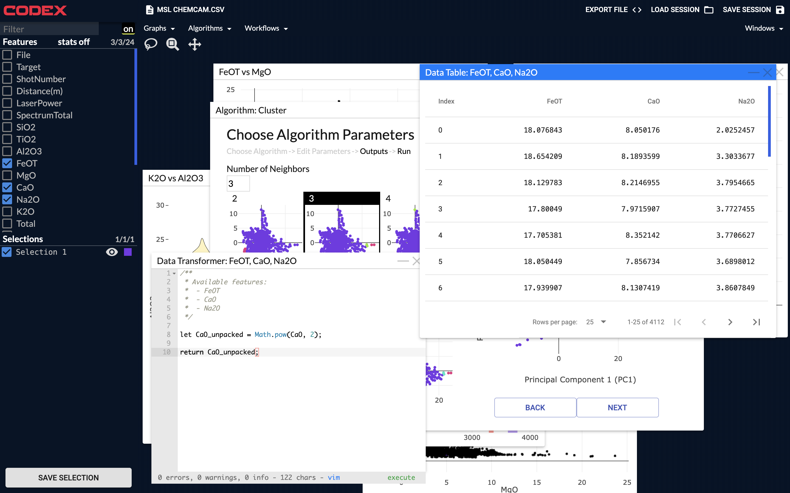

Slide 9
Unique Engineering Challenges
Requirements
Constraints
Must handle extremely large data sets (GB-TB range)
Performant
Run time estimations for actions
Preview actions
Both local + remote execution
Interactive plotting/graphing
Limited RAM + Performance
Javascript is single threaded
Web environments have tight restrictions on RAM usage
Constrained network load
Features can hit GB sizes
Both I/O and CPU bound on both frontend and backend
Notes:
Eng Challenges Diagrams

Slide 11
Under the Hood
Here be dragons

Slide 12









Technology Stack
Frontend
React.js/Redux
Plotly for plots
Websockets
Backend
Python/Tornado
Pebble (executor)
ZMQ (IPC)
Scikit + sklearn

Slide 13
UI Elements
Task 1
Task 2
Task 3
Task 4
. . .
Window Manager
Redux/Hooks (Application State Mgmt)
React (Host)
Frontend
Websocket
HTTP
Backend
Tornado (Application Server)
Static webserver
Worker Pool (Pebble)
Data Mgr. (Hash)
webpack bundle
Dockerized Python Environment
Physical Server

Slide 14
UI Elements
Task 1
Task 2
Task 3
Task 4
. . .
Window Manager
Redux/Hooks (Application State Mgmt)
React (Host)
90% of platform-
related challenges
occur here
Websocket
HTTP
Tornado (Application Server)
Static webserver
Worker Pool (Pebble)
Data Mgr. (Hash)
webpack bundle
Dockerized Python Environment
Physical Server

Slide 15
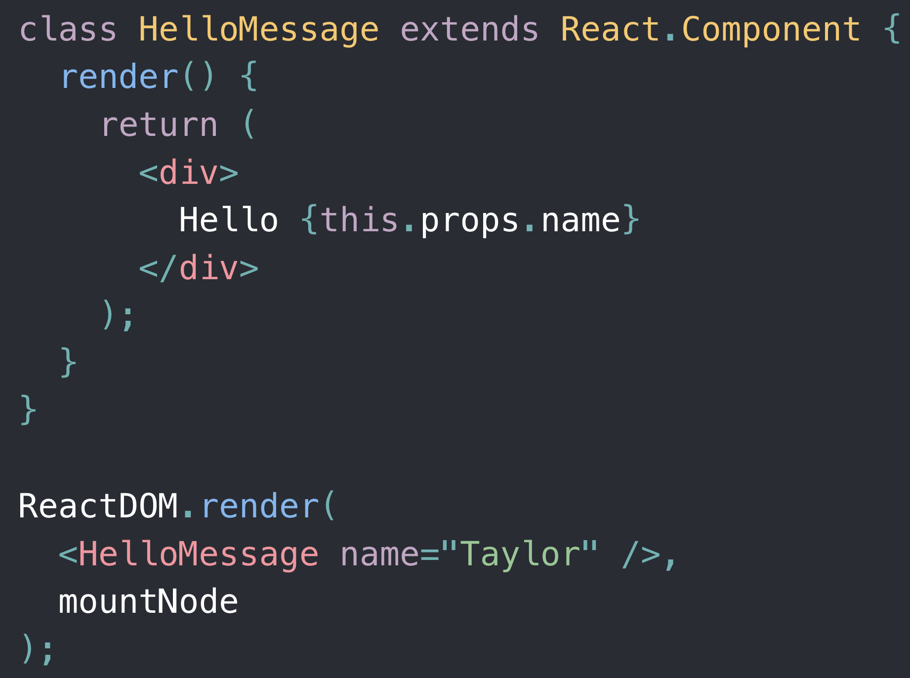
React.js
Javascript user interface library
Industry standard
Developed at Facebook
Component-based, declarative
JSX – mixes HTML markup and JS
Ideal choice for large web applications
Exponential complexity of “vanilla” applications
Provides per-component logic hosted in DOM tree

Slide 16


Frontend Data Management
Flux/Redux
Industry-standard state mgmt. for large applications
Developed at Facebook
Centralizes state, application is a function of central state
State is changed exclusively by actions processed by store
One-way data flow
Single source of truth for the app

Slide 17
Flux/Redux Overview
Application(State) = View
Notes:
Start with store

Slide 18
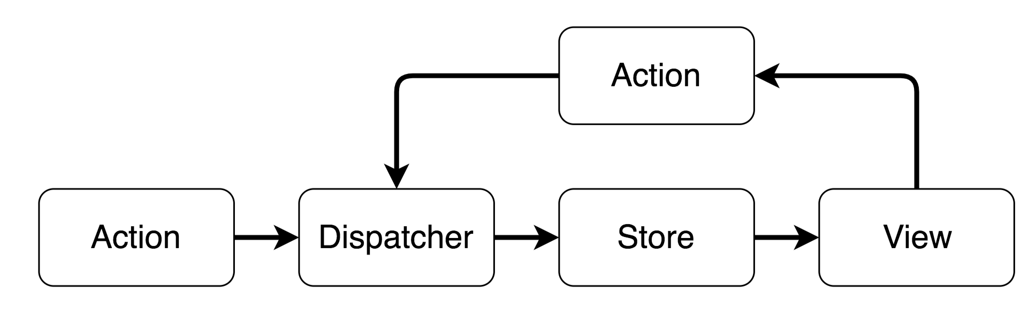
Flux/Redux Overview
Notes:
Start with store

Slide 19
Backend Refactor and Re-Architecture
Effective, scalable data management with tons of new features

Slide 20
New Features
Multi-tenant backends
Core requirement
Allows for single deployed instance of server
Easier sharing of compute resources
Significant performance improvements
More efficiently utilize available CPU cores
Processor intensive operations are significantly faster
Faster time-to-interactive with streaming requests
Send data as it becomes available

Slide 21

New Features (cont’d)
Support for changing datasets
Ensure your data doesn’t get corrupted
Allow for creating new features on your dataset
Simplified session management
Reliable, consistent data operations
Notes:
How we track data

Slide 22
Multi-tenant Backends / Data Consistency
Multiple users on one server
No longer one server for one user
Each session is assigned a key
Allows CODEX to be deployed onto larger datacenters
Pooling of compute resources allows for faster science
Data Consistency
Single source of truth for data
Allows for more efficient RAM usage
Session 1
Data
Store
Session 2
Data Mgr. (Hash)
Session 3
Session 4

Slide 23

Backend Performance Improvements
No longer subject to Python interpreter limitations
Can take full advantage of all cores
Significant on datacenters
CPU-intensive operations are no longer throttled
No longer limited to N features
Linear performance improvement with number of cores
Tasks can now be cancelled
Computation stopped when result is no longer needed
Quickly browse algorithms/features/actions without choking your computer
Notes:
GIL limits performance for CPU bound operations

Slide 24

Performance Improvements (cont’d)
Partial operation returns
Send data back before the operation is complete
For example, computing feature statistics
Reduces overhead of splitting requests up
Can stream operations as well
(e.g. regression/optimization/curve fitting, etc.)

Slide 25
Request Performance Comparison
STEP DIAGRAM OF
OLD REQUEST FLOW
STEP DIAGRAM OF
NEW REQUEST FLOW

Slide 26
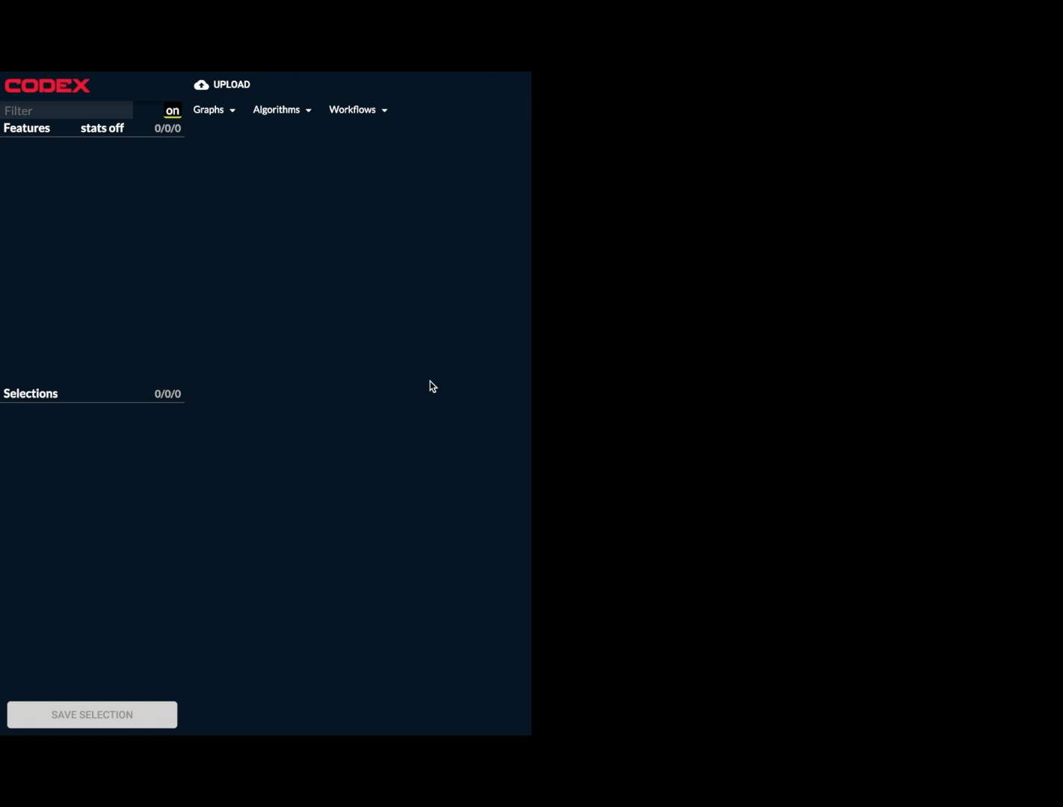
Lowered Time-To-Interactive

Slide 27
Implementation Details
Mixed ThreadPool/ProcessPool/Async approach
ThreadPool manages waiting on execution ProcessPool
I/O-bound ops are managed by an async single-t
Optimal strategy for CPU bound operations
Serializing return values into queue, exhausting generators
CODEX Data Hash Process
Data reading and writing isolated to a process
Sessions are cached according to key
Pickle over ZeroMQ
Queued Read/Writes

Slide 28
Window/Data System Refactor
Data performance and developer performance upgrades
Notes:
CFG change, redux, hooks, BSP, feature lifetimes, etc.

Slide 29
Notes:
All this data comes with a cost

Slide 30

Developer Overhead Reduction
Reduced the overhead for creating new features
Registration takes less than half the file changes
Centralized configuration on the components
Debugging is significantly faster
All WM state is now managed by Redux
Performance – now 60fps
More powerful APIs
Garbage collected features
Embrace React Hooks
Window reflection
Sessions restore window states

Slide 31
Example: Window Creation
+ more

Slide 32
Garbage Collection
Declarative API for managing features
Components declare their dependencies
Set of tooling to request data and implement reference counting
Satisfies frontend RAM constraints
Lightweight implementation due to CPU constraints
Component
Idle
Component
Render
Resolution
Fetch
(if req’d)
Add Ref
GC API

Slide 33
Data APIs
Embrace React Hooks
Previously difficult to write re-usable logic that relied on lifecycle logic
Composition is a breeze
Provides APIs for:
Garbage collection
Session management
Streaming data
Uploading files
Selection creation/management
Window management
Feature metrics
Feature creation

Slide 34
New Exploration Tools
Built on this new foundation

Slide 35
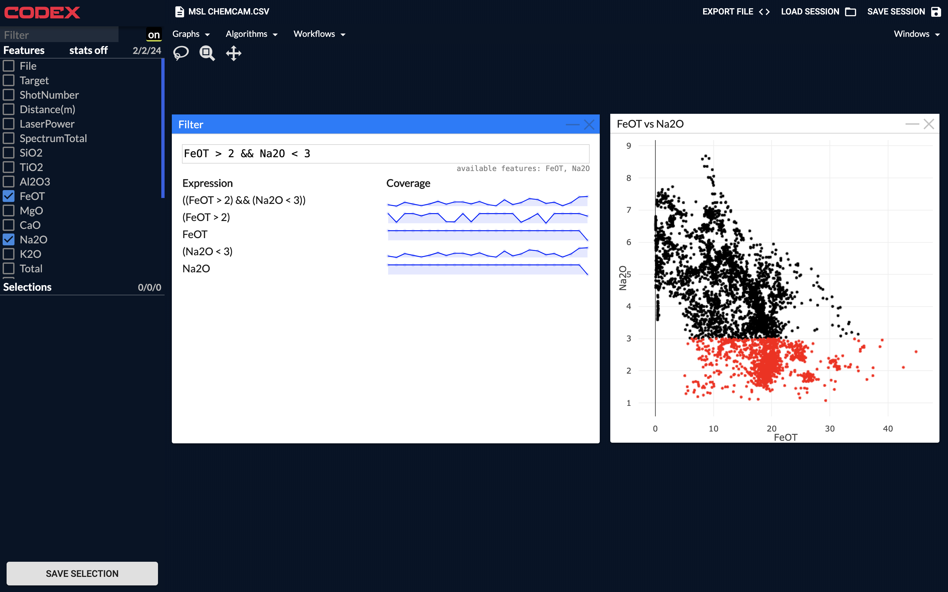
Notes:
Voltage over .5

Slide 36
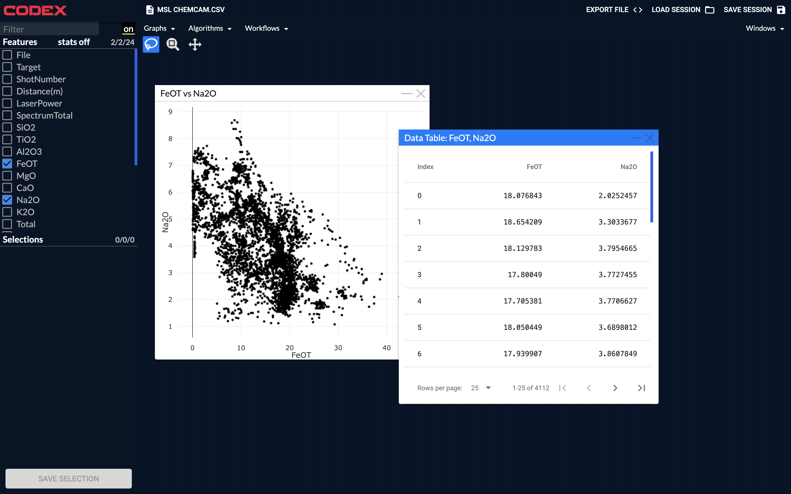

Slide 37
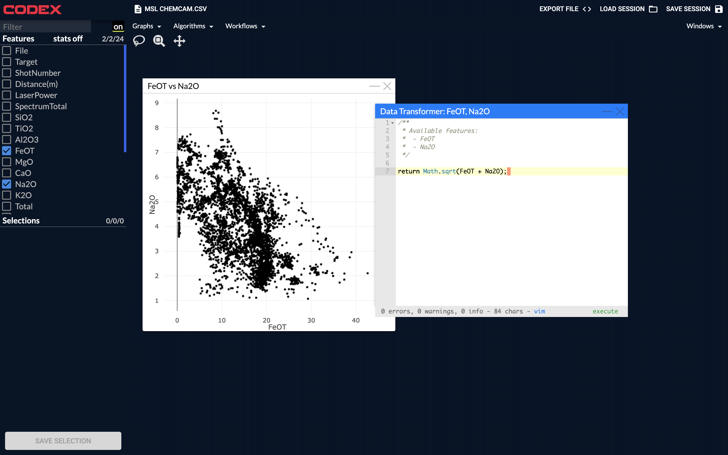

Slide 38
Future Work
Backend transfer
Hot-move session from local machine to datacenter
Fallback to local server if connection drops
Quality Scan interface
Scan through dataset for anomalies
NaNs, infinities, negative values, repeated values, outliers, etc.
Requires a lot of infrastructure

Slide 39
Acknowledgements
Jack Lightholder
Josh Rodriguez
Rob Tapella
Alec Helbling
Lukas Mandrake

Slide 41
Backup
Useful for reference

Slide 42
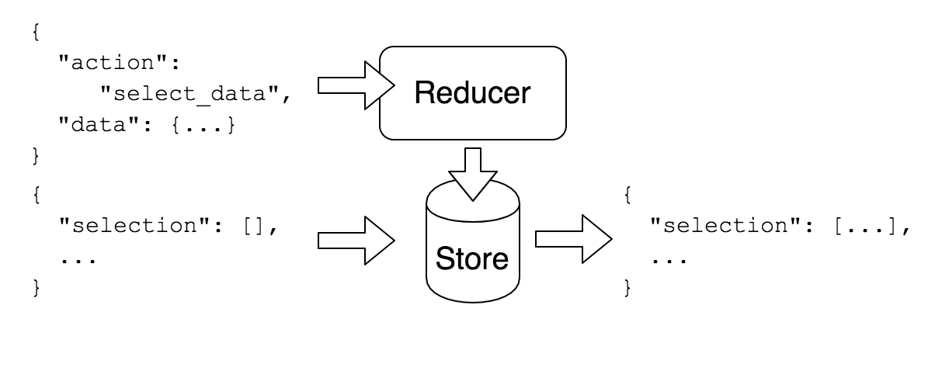
Flux/Redux Refactor

Slide 43
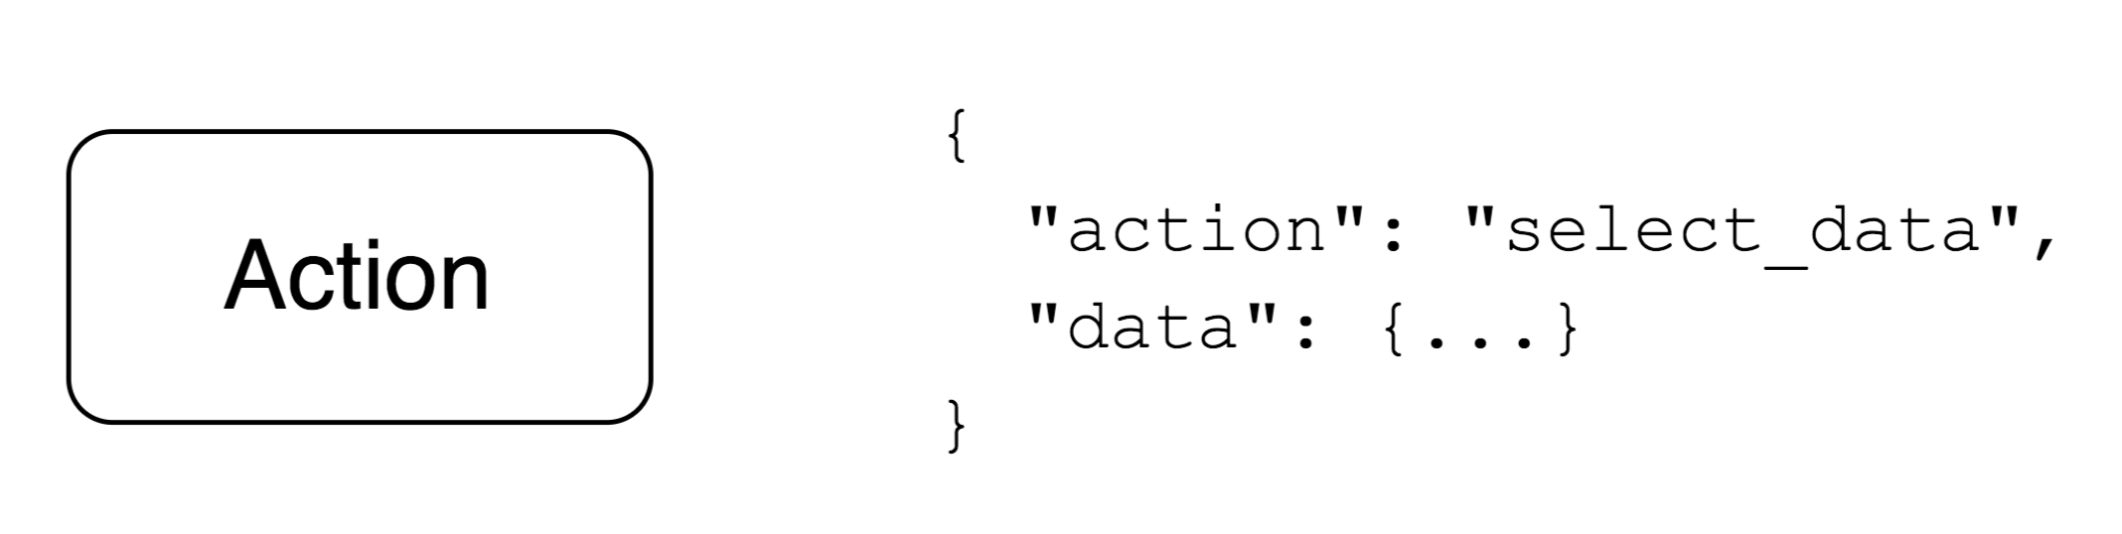
Flux/Redux Refactor

Slide 44
from catb.org/jargon
heavy wizardry: n.
Code or designs that trade on a particularly intimate knowledge or experience of a particular operating system or language or complex application interface. Distinguished from deep magic, which trades more on arcane theoretical knowledge. Esp.: found in source-code comments of the form “Heavy wizardry begins here”. Compare voodoo programming.
Notes:
http://catb.org/jargon/html/H/heavy-wizardry.html
http://catb.org/jargon/html/D/deep-magic.html
http://catb.org/jargon/html/V/voodoo-programming.html

Slide 45
Thread Pool to Process Pool
ThreadPool limits concurrent performance
Global Interpreter Lock was shared between all server threads
Performance severely limited by GIL
Python standard library’s ThreadPool is uncancellable
ThreadPool dispatcher replaced by ProcessPool dispatcher
Challenges with synchronization of async/concurrent pooling
Asynchronous Tornado event loop in main thread is incompatible with ProcessPool Queues
ProcessPool returns cancellable concurrent.futures

Slide 46
CODEX Hash Process Transition
Data in CODEX is hashed to manage larger-than-RAM datasets
Data sets and features are referenced by caching
Hash suite separated onto its own process
IPC managed by pickle over ZMQ
No longer has data inconsistency
Writes are queued from worker threads
Reads wait until writes are finished
Notes:
so what ?

Slide 47
Previous state
Single user backend
No session isolation
Unkeyed data hashing
No support for changing datasets
Write-unsafe data manager
Inconsistency across threads
Copied by Python into threads
Locked to ThreadPool, single request/response stream
Limited performance due to Python GIL
Single request build and tear down overhead
Notes:
Pre-refactor conditions
Up until this summer we only had these capabilities
More about what the effects of these could do

Slide 48
Streaming Requests
Previously, every request included a creation/teardown step
Built for multiple unrelated requests
Significant overhead with Websocket/data lock
Request handlers can now be generators
Perform multiple related analyses
Lower overhead
Stream results as they become available
Most algorithms require multiple feedback steps
STEP DIAGRAM OF
OLD REQUEST FLOW
STEP DIAGRAM OF
NEW REQUEST FLOW

Slide 49
Complexity Comparison
const Component = props => {
const win = useWindowManager(props, {
title: 'Example'
});
const features = usePinnedFeatures(win);
}

Slide 50
Impetus for Refactor
NEEDS PRETTY GRAPHS
Overhead to extending CODEX was very high
Multiple configuration changes
~7 files needed to be kept in sync
No way to modify windows after creation
Difficult-to-reproduce bugs due to internal WM state
Data required by window would be opaquely resolved with little feedback
RAM usage was high
Data features would be stored on the frontend as needed, and were never recycled
No concept of GC/other management strategies

Slide 51
Refactor Changes
NEEDS PRETTY GRAPHS
WM state promoted to central CODEX state manager
Allows for arbitrary components to reliably influence the state of the WM
Windows can set their own configuration, and handle requesting the data that they need
Reduces configuration overhead to just 3 files (57%)
Data resource management
Features requested by the backend are subject to automatic reference counting
Low-overhead garbage collection implementation
Unused features will be removed in low-memory environments
Notes:
Bar Charts

